Slide 1
A. RAMEEZA
Assistant Professor of Commerce
Jamal Mohamed College
(Autonomous)
Trichy-20

Slide 2
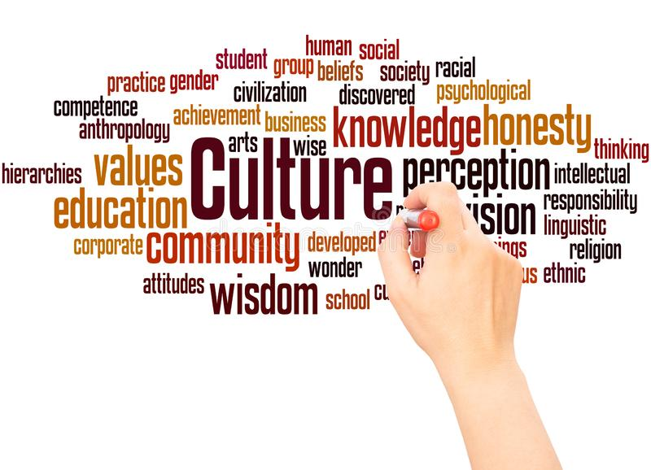

Slide 3
Culture
"Culture encompasses religion, food, what we wear, how we wear it, our language, marriage, music, what we believe is right or wrong, how we sit at the table, how we greet visitors, how we behave with loved ones, and a million other things," Cristina De Rossi, an anthropologist at Barnet and Southgate College in London, told Live Science.
The word "culture" derives from a French term, which in turn derives from the Latin "colere," which means to tend to the earth and grow, or cultivation and nurture. "It shares its etymology with a number of other words related to actively fostering growth, hat is
Culture is the Centre of a society and without culture no society can even exist. It is the main difference between human beings and animals. It is a heritage transmitted from one generation to another. It includes all the ways and behaviours is social life. Man is born in the environment of culture, in which he seeks his way of behaving and acting in a given society.

Slide 4
Definition
Terpstran defined,
“The integrated sum total of learned behavioral traits that are manifest and shared by members of society”.
Lustig and Koster,
“A learned set of shared perceptions about beliefs, values, norms, which affect the behaviors of a relatively large group of people”.

Slide 5
Features of culture
Learned
Transmitted
Based on symbols
Subject to change
Integrated
Ethnocentric
Adaptive
Shapes values and beliefs
Determines personality
He common and distinct elements
Integrated system

Slide 6
Elements of Culture
1. Values
2. Beliefs
3. Aesthetics
4. Symbols
5. Language
6. Non verbal communication
7. Norms
8. Mores

Slide 7
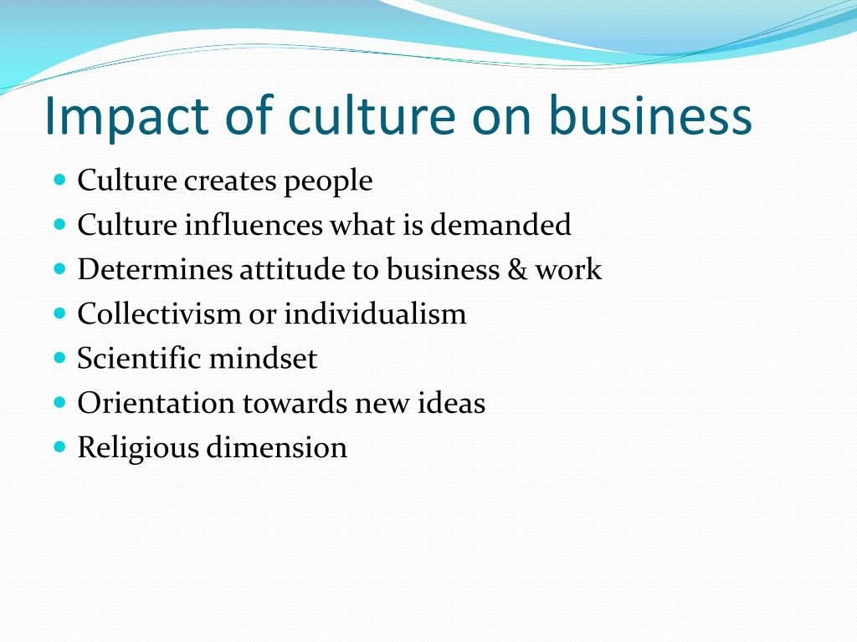

Slide 8
Foreign Culture
Foreign Culture
Any culture which belongs to other countries is termed as foreign culture. In other words, culture from outside the national boundaries is foreign culture.
Foreign culture is a culture that is new or unknown to a people of a native region. The opposite of foreign culture is local culture.
Advantages of foreign culture
Expanding their knowledge in the acceptance of other cultures.
Personal development capacity.
Walking pace with society.
Promoting their national culture.
Getting a job opportunity
Disadvantages of foreign culture
Confusion own identity if we do not have enough knowledge to own culture.
No value on traditional culture.
Copy from foreign cultures
lack of proper understanding.

Slide 9
Influences of Foreign culture
Dress patterns
Food
Language
Greeting
Occasions
Entertainment
Family System
Position of Elders
Role of women
Consumption pattern
Consumerist culture

Slide 10
Impact of Foreign Culture on Business
In manufacturing, companies have implemented modern concepts
Inventory is managed more effectively through adoption
Raw materials and components are purchased at cost efficient prices from global vendors.
Supply chain management practices are becoming more efficient.
More Indian companies are setting up separate Research and development labs to innovate and compete with global brands.
Modern technologies are adopted in all areas to improve efficiency, quality and reduce costs.
Business are using IT in most of their business areas.

Slide 11
Impact of Foreign Culture on Business
Most of the companies have computerized their operations.
Companies are using western marketing techniques.
HR concepts from the developed countries are being implemented.
Accounting statements are prepared both under Indian Accounting standards and Generally Accepted Accounting Principles by Indian companies operating in foreign countries.
New business models of foreign countries are being adopted in India.
Payment and money management tools from foreign countries are now used in India.
Foreign culture has an important impact in the Indian hospitality industry.

Slide 12


